Slide 1
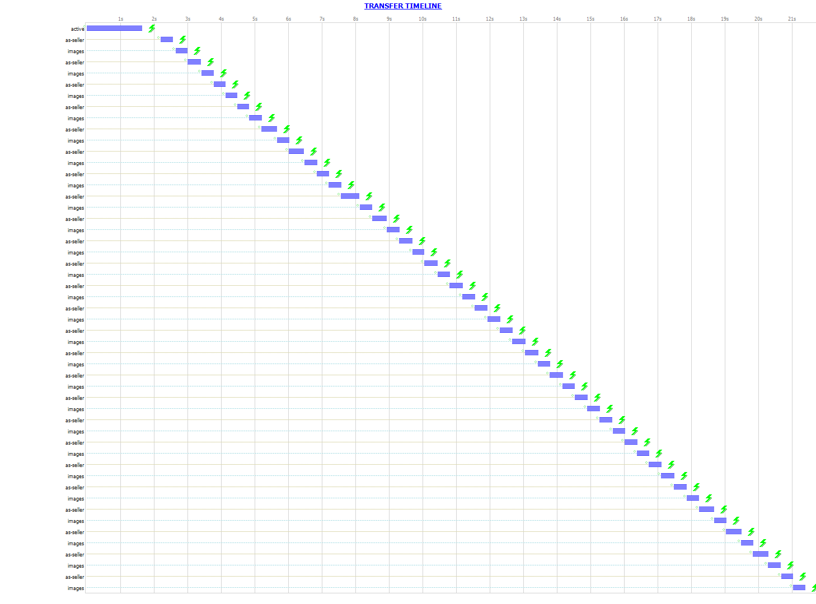
FLOW B (Imperative)

Slide 2
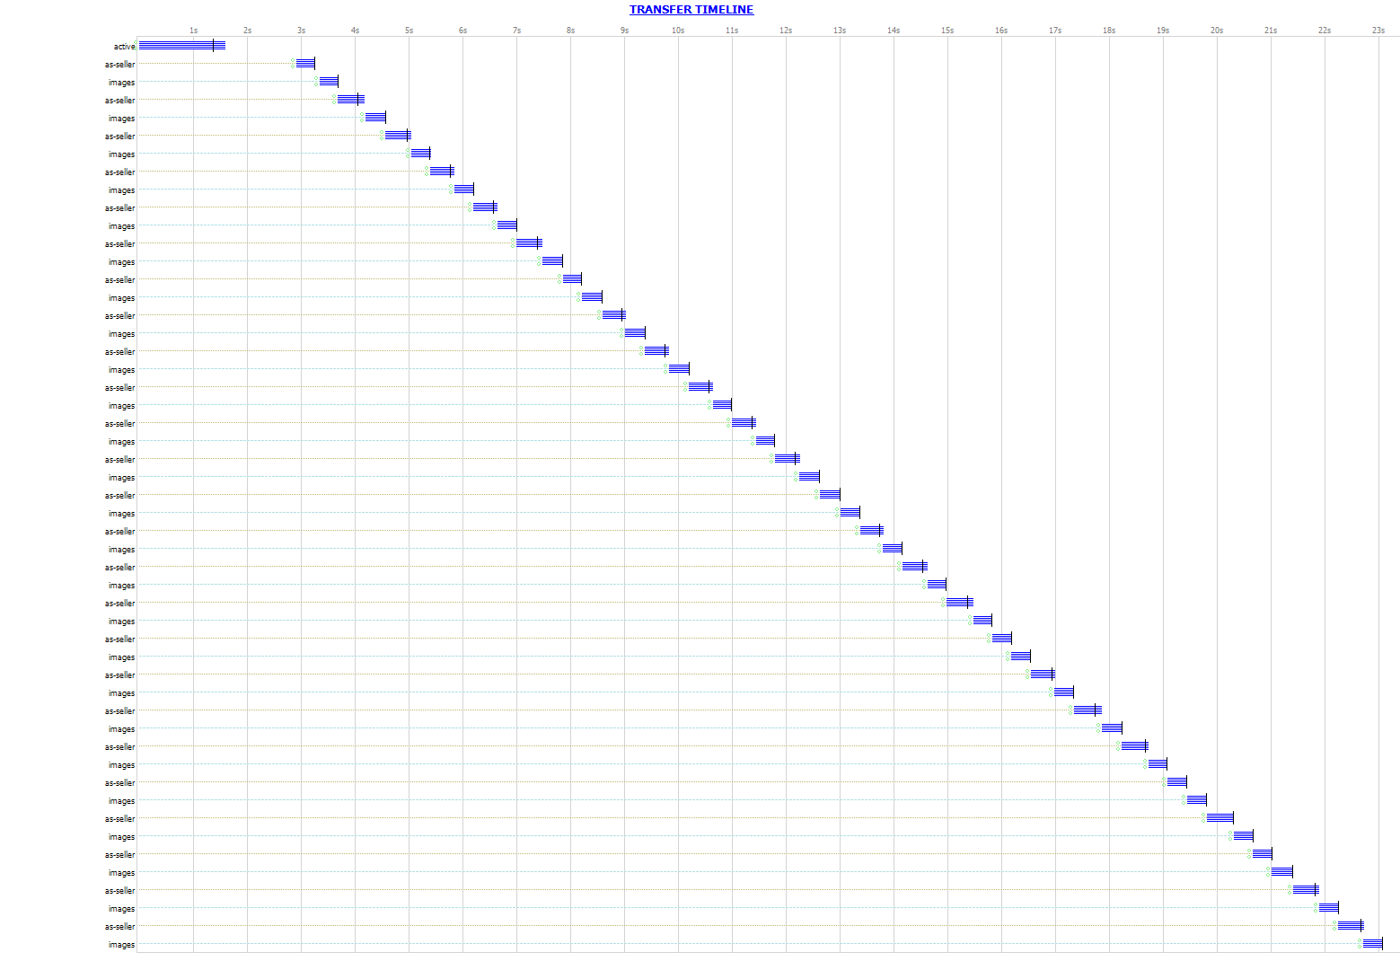
FLOW C

Slide 3

FLOW D

